Slide 1
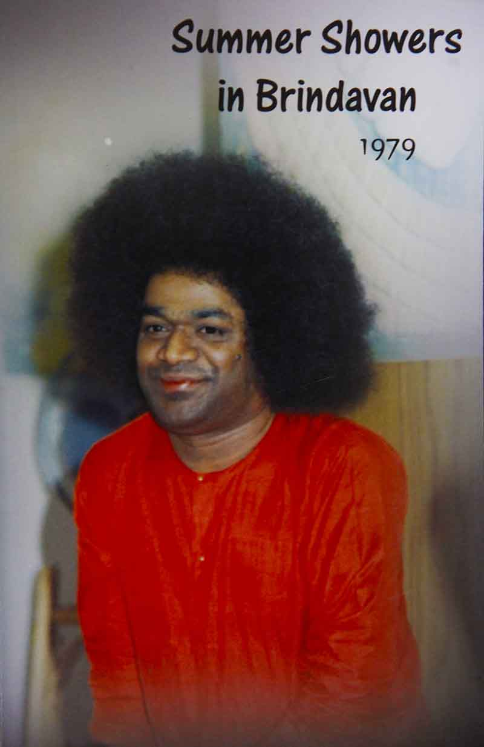
Spirituality and Society
Chapter 5 in SSB 1979

Slide 2
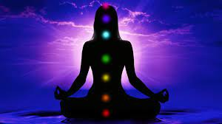
Backbone
Many fallaciously imagine that spirituality is only concerned with salvation. Spirituality is, in fact, the backbone of society and is indispensable for social progress and solidarity.

Slide 3
Individual-Easwara Connection
Easwara manifests Himself among individuals who aggregate together to constitute a community. Every individual is an aspect of Easwara. Likewise, society too has emerged from Easwara. An individual has form, but society has no such definable form. In the same manner, the world is visible, but Easwara is invisible. Though He is invisible, His existence becomes indisputable because there cannot be creation without a creator. Just as a fabric cannot come into existence without thread and a pot without mud, so also the universe cannot come into existence without the primordial substance of Brahman.

Slide 4


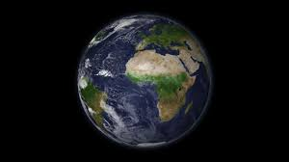

Slide 5
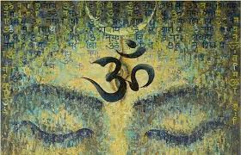
Basis
Brahman is the basis, the substance, the prime mover and also the “enjoyer” of the universe.

Slide 6
Levels of Dharma
It is emphasized that we should not reject swadharma or our own dharma. But what is this swadharma? The Bhagavad Gita contains an elaborated and lucid exposition of the concept of swadharma. Krishna enlightens Arjuna on the meaning and significance of swadharma. Swadharma is mainly concerned with individual attributes. Vishwa dharma is higher than swadharma. Vishwa dharma is universally applicable dharma. Vishwa dharma is the cosmic dharma of Brahman. Easwara dharma emerges from vishwa dharma. Samajika dharma or the dharma of society emerges from Easwara dharma, the dharma of God. Vyakti dharma or individual dharma emerges from samajika dharma, and this vyakti dharma is synonymous with swadharma.

Slide 7
VISHWADHARMA
EASWARA DHARMA
SAMAJIKA DHARMA
SWADHARMA
VYAKTI DHARMA
=

Slide 8
Swadharma?
It is said “Samathvam Yogamuchyate”. The sentence is vibrant with thought and meaning. The word samathva may be roughly interpreted as equanimity. The popular meaning of swadharma is the code of conduct or scale of values adopted by any particular caste, community, creed or religion. But this is not the correct interpretation and it is not acceptable to all groups of people. There are no universal and absolute norms of morality. Ethical relativity is an inescapable social phenomenon. Morality depends on the time, the place and the spirit of the age. Differences are obvious in our mundane world.

Slide 9
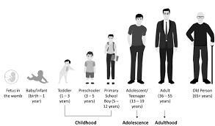
Swadharma!
There are all sorts of people in the world. There are men, women and children of different age groups. There are infants, adolescents, young men and women and old men and women. The dharma of women cannot be the same as the dharma of men. There is, in nature, an inherent inequality. Thus, it becomes ridiculous to adopt a single ethical code for the entire mankind. Each individual has his own dharma, but it need not militate against the dharma of others.

Slide 10
So, what is Swadharma?
In the Bhagavad Gita, Arjuna finds himself on the horns of a spiritual dilemma. He is worried about his swadharma. He finds himself in an unenviable predicament. He hesitates to kill his own relatives and be guilty of fratricide. So, he begins to detest the homicidal glory of a battlefield. Then, Krishna teaches the importance of swadharma. Swadharma is individual dharma or a code of conduct in conformity with an individual’s status in society. It is also determined by a person’s natural instincts.

Slide 11
Are you this body?
Swadharma or individual dharma is transcended by a person who recognises and realises the immanence of Easwara. “Easwara Sarva Bhutanam”. The moment you comprehend the truth of this cardinal aphorism, you realise Easwara Dharma, the theocentric order in nature. Thus, swadharma is lower than Easwara dharma and vishwa dharma. When you recognise the divinity of every human being, you realise Easwara dharma. You will be subject to the dualities of pleasure and pain, joy and sorrow, good and evil as long as you identify yourself with the perishable and mutable physical body.

Slide 12
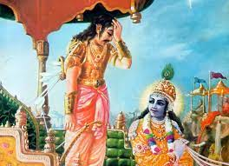
Are you this body?
Arjuna was afflicted with weakness of mind and heart. Krishna chastised Arjuna for his moral and spiritual cowardice. As long as you are weak and timid, you cannot achieve anything in life. Sentimentality and body consciousness should be avoided. As long as you think from the point of view of the perishable body, you cannot overcome your spiritual pusillanimity. When you think from the point of view of the immortal Atma, you will have no feelings of weakness and timidity. By these exhortations, Krishna galvanised Arjuna into activity on the battlefield.

Slide 13
Atma
The duties, dichotomies, and relativities of the world do not affect the immortal Atma. The coexistence and juxtaposition of good and evil should be acknowledged. From the point of view of the Atma, good and evil are only phenomenal and not absolute.

Slide 14

You are responsible!
The realisation of the Atma is impeded by envy, malice, and jealousy which are caused by attachment to the perishable physical body. All people do not derive the same benefit from the Gita. It all depends on the deservedness and purity of the individual. Ultimately, the individual is responsible for everything that he does.
Human beings may not be able to even imagine the sublime bliss of spirituality as long as they prefer to wallow in the mire of slothfulness.

Slide 15
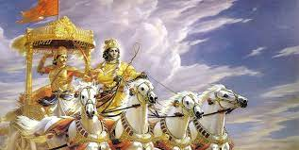
A single sloka from the Gita is enough to transform our lives. Steadfastness (Sraddha) is necessary for acquiring the knowledge of spirituality.

Slide 16
Indra’s story
Once, Indra was born as a pig on account of a curse. He forgot his past glory, married a sow, and raised a family of little pigs. He felt supremely happy and forgot his divinity. Narada took pity on him and made him realise his real destiny. Human beings also forget their divinity and attach themselves to sensual pleasures.

Slide 17
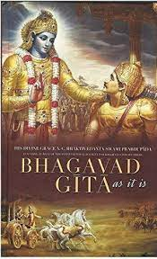

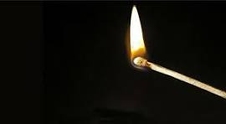
Matchbox Analogy
A matchbox may contain as many as fifty sticks. But, a single match is enough to light a lamp, for dispelling the darkness in a place. Similarly, a single sloka from the Gita is enough to bring the light of wisdom and dispel the darkness of ignorance. But, without sraddha or perseverance, the Bhagavad Gita will remain a sealed book.

Slide 18
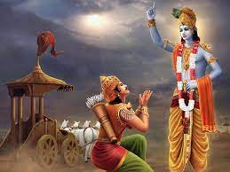
Phenomenal vs. Incorporeal
Krishna told Arjuna, “You are not the killer in the real sense. You think that you are going to kill your enemies. Killing is only phenomenal. You are instrumental in this process of destruction, purification and the resurrection of dharma. You would not be unnecessarily perturbed if you were to remember that the corporeal body is transient and the incorporeal Atma is immortal.”

Slide 19
Vyasa’s blessings
For instance, the words, “Samatvam yogam uchyate” or ‘equal-mindedness is called yoga’, were expanded into twelve verses by Vyasa; the phrase “Kshudram hridaya-daurbalyam” or ‘detestable is weakness of the heart’ was elaborated into twenty-two verses; the verse “anityam asukham lokam imam praapya bhajasva maam” which means ‘having got this transitory, miserable world, worship Me’ was made into seven verses; and the aphorism, “nayamatma balahinena labhyah” or ‘this Atma cannot be attained by the weak’ was explained in nine different verses.

Slide 20
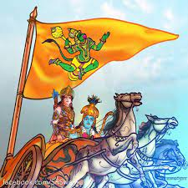
The Silent Listener
Hanuman, who was on the flag of Arjuna’s chariot, overheard the Gita and expounded it in twenty-one verses in the Paisachi language.

Slide 21

Read Bhagavad Gita
The Bhagavad Gita contains the quintessence of all scriptures. It should be studied assiduously by every spiritual aspirant. It should also be regarded as a book of great practical value in our daily lives. It has given solace to many and it will help your spiritual progress.

